Slide 1

Gold Price Prediction
By Natibundit Suntrarnusorn 300360042
& Kartik Vedi 300374518
Notes:
To change the image on this slide, select the picture and delete it. Then click the Pictures icon in the placeholder to insert your own image.

Slide 2
Overview of Project
Objective:
Predicting gold prices is crucial for investors and financial analysts to make informed decisions in the market.
This project aims to develop models that can accurately forecast gold prices based on various factors.
Significance:
Gold is a key asset in investment portfolios, often serving as a hedge against economic uncertainty.
Accurate predictions of gold prices can help optimize investment strategies and mitigate risks for stakeholders.
Approach:
Utilized machine learning algorithms to analyze historical gold price data along with related factors such as stock indices and currency exchange rates.
Explored different regression models to determine the most effective approach for gold price prediction.
Importance:
Understanding the factors influencing gold prices can provide insights into broader economic trends and market sentiment.
Effective prediction models contribute to more informed decision-making in the financial sector, ultimately enhancing investment outcomes.

Slide 3
Part 1: Gold Price Prediction For Classification Model

Slide 4
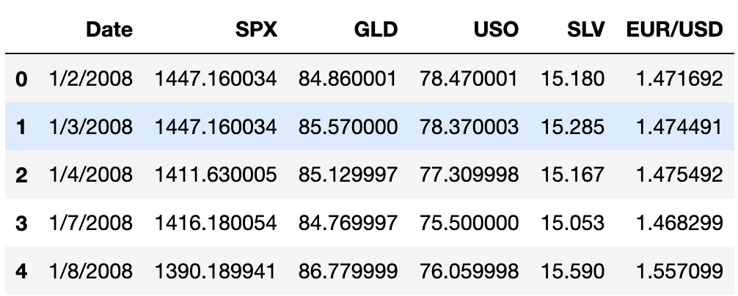
Original Dataset
Notes:
The provided dataset covers financial data from January 2, 2008, to an unspecified end date, likely spanning multiple years. It includes information on key financial indicators such as the S&P 500 index (SPX), gold prices (GLD), crude oil prices (USO), silver prices (SLV), and the Euro to US Dollar exchange rate (EUR/USD).
Each row in the dataset corresponds to a specific date, starting from January 2, 2008, and contains corresponding values for the mentioned financial indicators. This granular daily data allows for the analysis of trends and fluctuations in the financial markets over time.
The dataset serves as a valuable resource for conducting various analyses, including correlation studies and predictive modeling. Understanding the relationships between these financial indicators can provide insights into market dynamics and assist in making informed investment decisions.

Slide 5
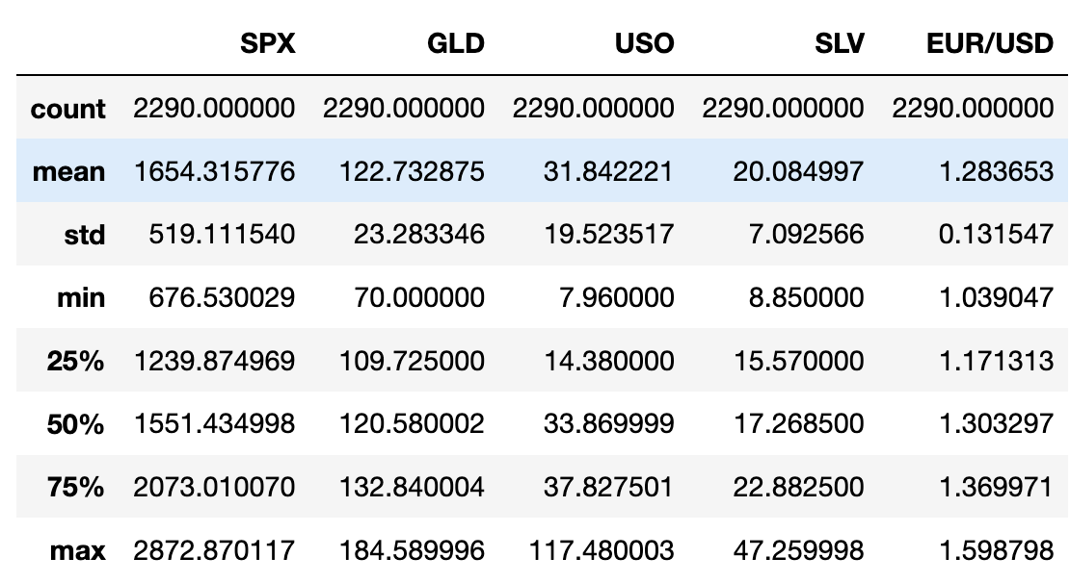
Cleaning Data
Cleaning Data:
Select necessary attributes: Keep only the relevant columns such as 'Date', 'SPX', 'GLD', 'USO', 'SLV', 'EUR/USD'.
Check for any missing values: Use df.isna().sum() to identify missing values in each column and handle them appropriately.
Exploratory Data Analysis:
Descriptive Statistics: Utilize df.describe() to obtain an overview of the dataset's numerical attributes, including count, mean, standard deviation, minimum, maximum, and quartile values.
Correlation Analysis: Calculate the correlation matrix to explore the relationships between different financial indicators such as 'SPX', 'GLD', 'USO', 'SLV', and 'EUR/USD'. This helps identify potential multicollinearity issues and understand how variables interact.
Notes:
Cleaning Data:
Select necessary attributes: We start by selecting only the essential columns required for our analysis, which include 'Date', 'SPX', 'GLD', 'USO', 'SLV', and 'EUR/USD'. This ensures that we focus on the relevant financial indicators.
Check for any missing values: We then check for missing values using df.isna().sum(). Identifying and handling missing data appropriately is crucial to ensure the integrity of our analysis and model performance.
Exploratory Data Analysis:
Descriptive Statistics: Using df.describe(), we obtain descriptive statistics for the numerical attributes in our dataset. This summary provides insights into the central tendency, dispersion, and shape of the distribution of each variable.
Correlation Analysis: We calculate the correlation matrix to examine the relationships between different financial indicators such as 'SPX', 'GLD', 'USO', 'SLV', and 'EUR/USD'. This analysis helps us understand the degree and direction of linear associations between variables, aiding in feature selection and multicollinearity detection.

Slide 6
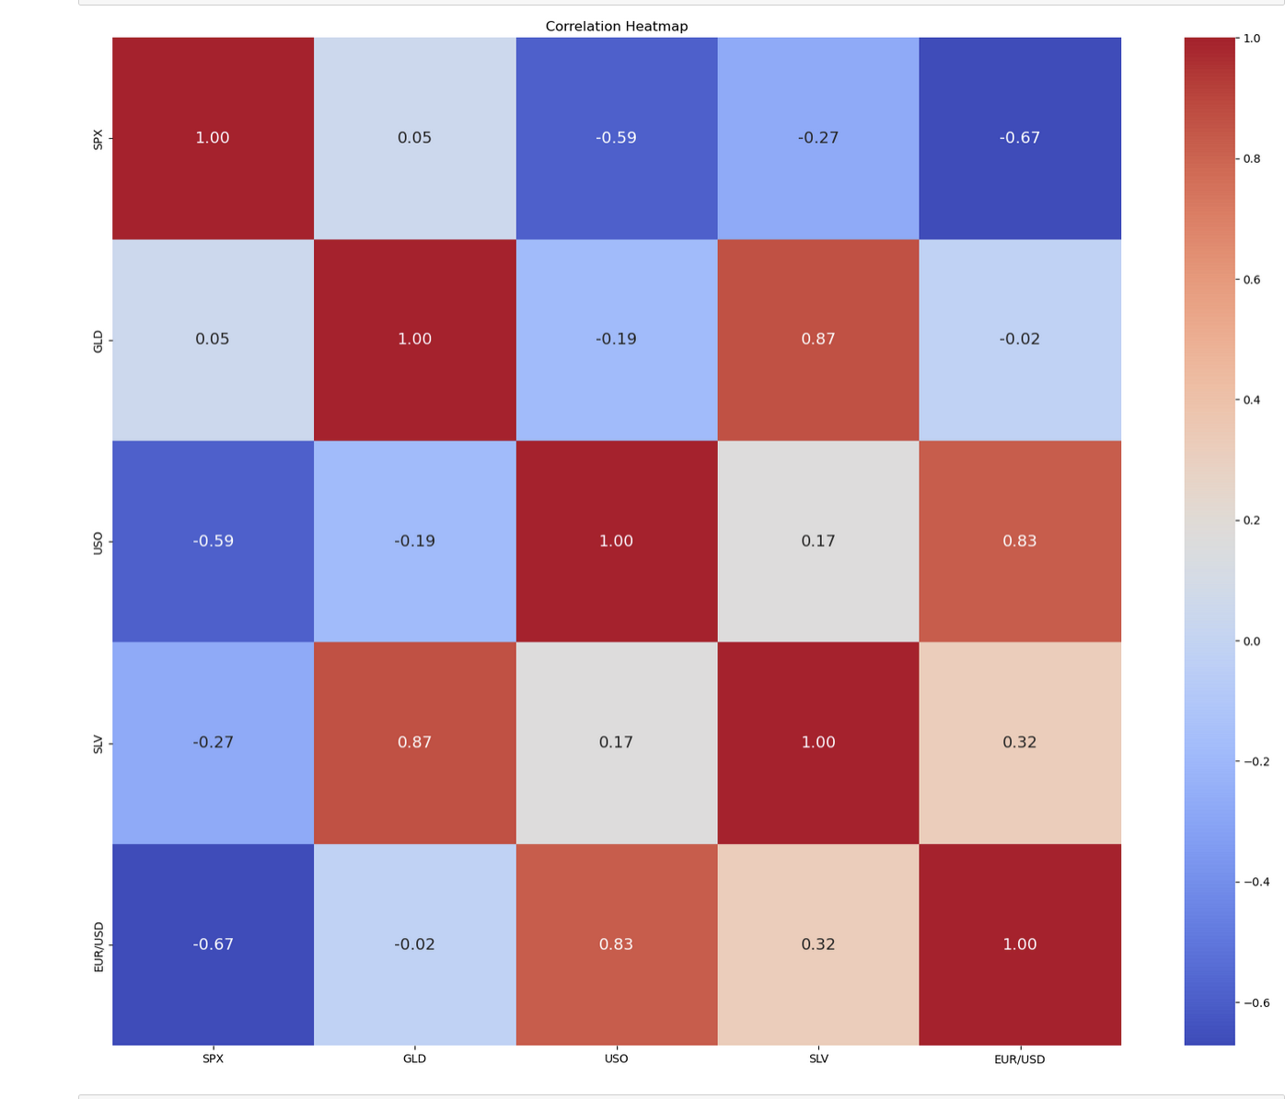
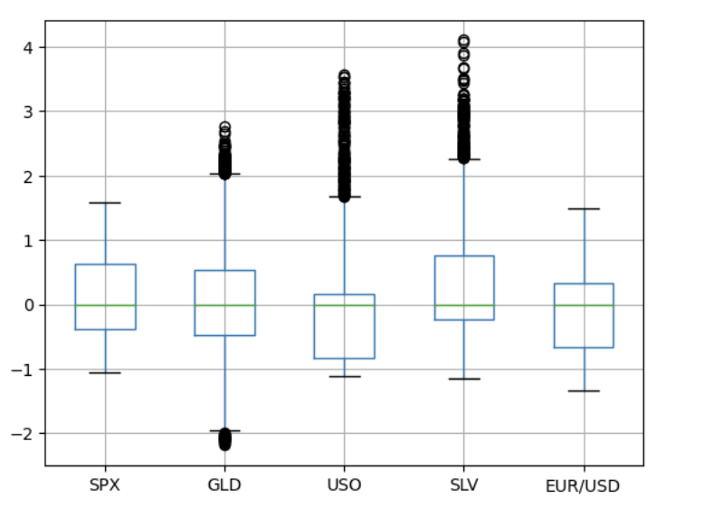
Data Exploration

Slide 7
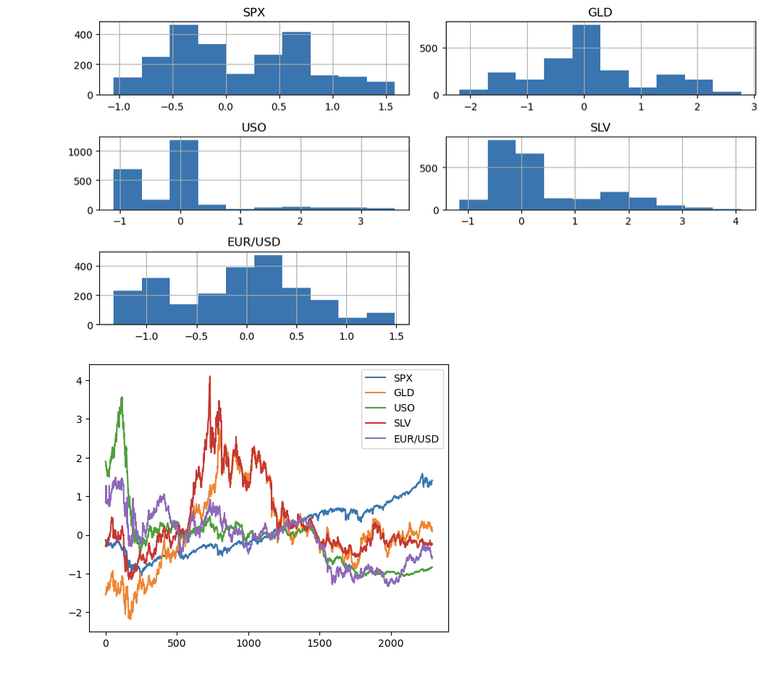
Data Exploration

Slide 8
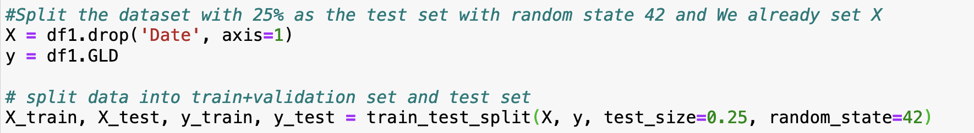
Classification Model and Evaluation
Utilized the train_test_split function to randomly divide the dataset into training and testing sets, with a 75:25 ratio respectively.
Employed a random state (random_state=42) to ensure reproducibility, facilitating consistent results across analyses.

Slide 9
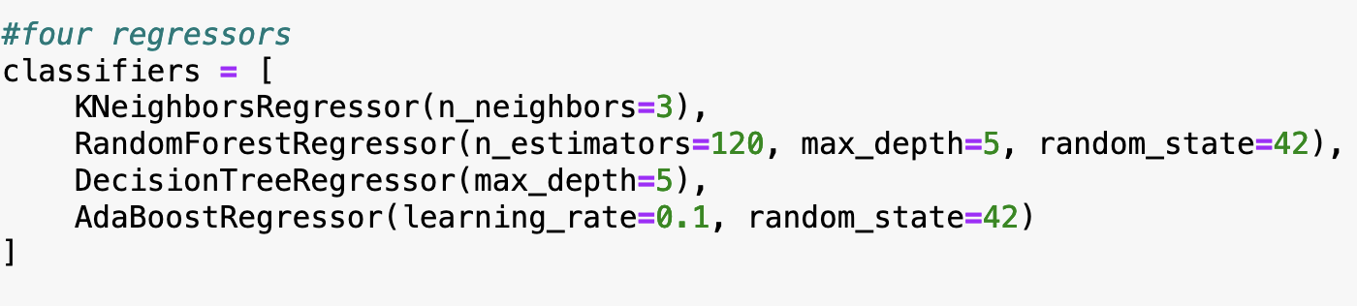
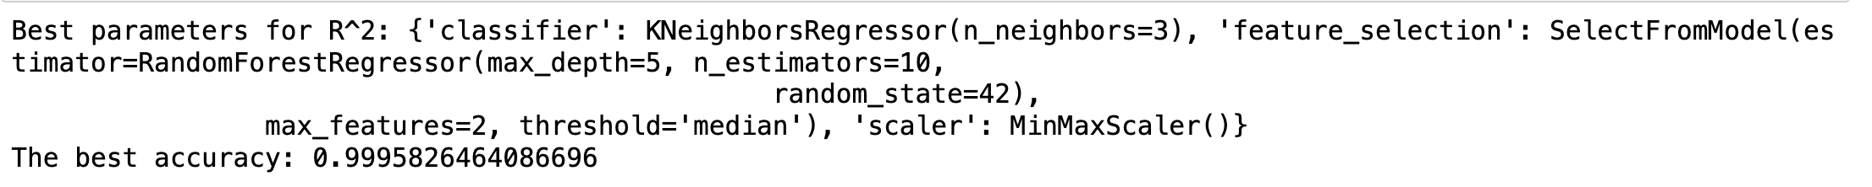
R-Square

Slide 10
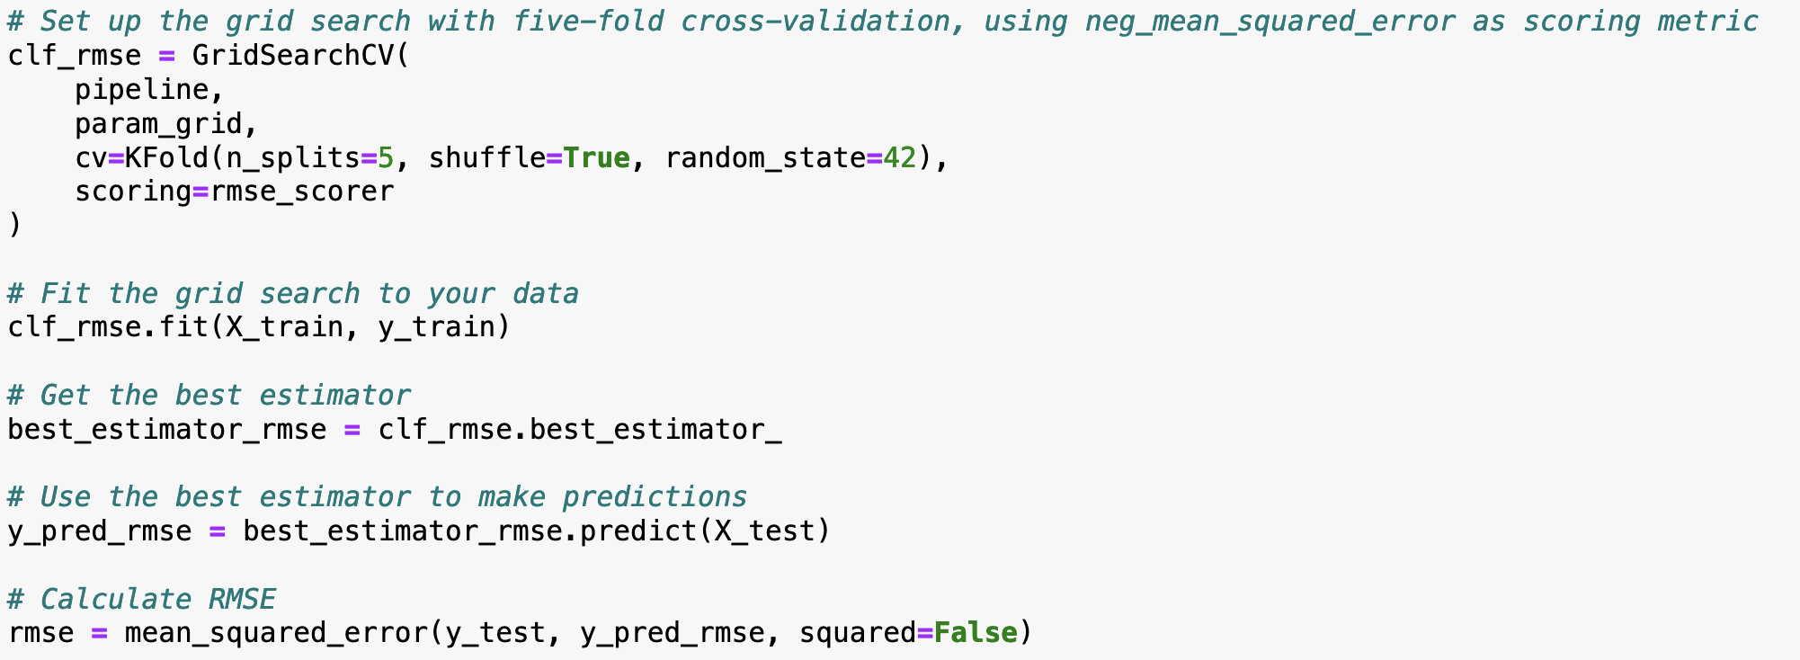
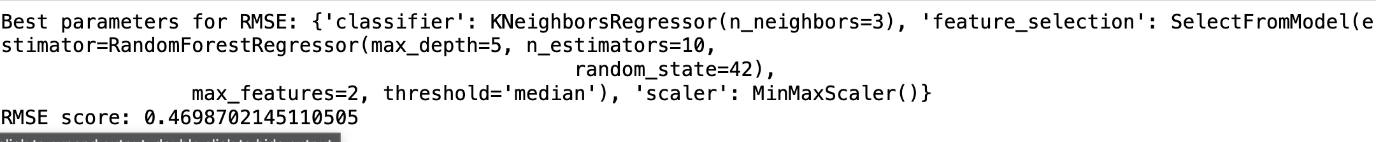
Root-Mean-Square-Error (RSME)

Slide 11
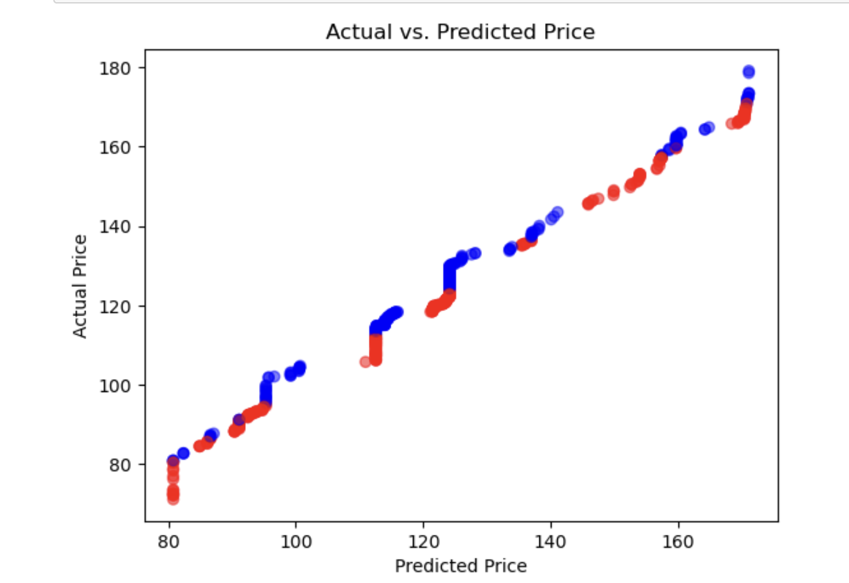
Plotting the prediction vs actual graph
Notes:
Plot Overview:
Illustrates the comparison between predicted and actual prices.
X-axis displays predicted prices generated by our model.
Y-axis represents actual prices observed in real-world data.
Interpretation of Points:
Ideally, points should align along a diagonal line.
Deviations from this line indicate model inaccuracies.
Points above the line signify overestimation, while those below indicate underestimation.
Model Evaluation:
Analysts use scatter plots to assess model effectiveness.
Tight clustering around the diagonal line suggests a well-calibrated model.
Outliers or systematic deviations signal areas for improvement.

Slide 12
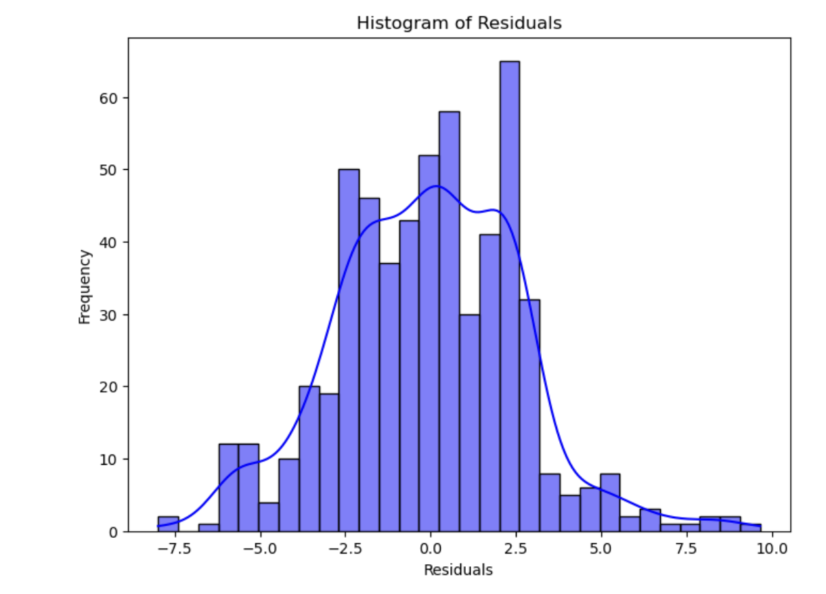
Residual Histogram
Notes:
Purpose:
Visualizes the distribution of residuals.
Residuals represent the differences between actual and predicted values.
Essential for assessing model performance and assumptions.
Model Assessment:
Helps analysts evaluate model accuracy and assumptions.
Ideally, residuals should follow a normal distribution around zero.
Deviations from normality may require model adjustments.

Slide 13
Part 2: Gold Price Prediction For Sentimental Analytics

Slide 14
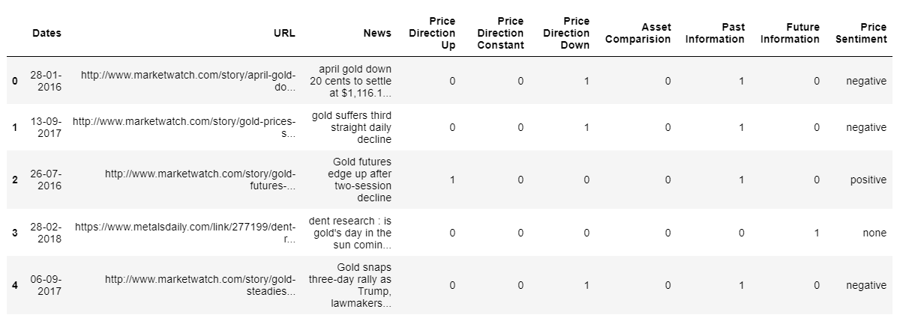
Original Dataset
Notes:
1.The original dataset contain the release data of gold news on a various website from 2000 to 2019
2.Extract URL headline from URL into text message
3.Select only columns Dates, News and Price Sentiment for text analytics process

Slide 15
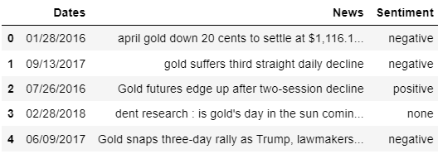
Cleaning Data
Select necessary attributes
- Delete missing value
- Convert 'Dates' column into identical format of first dataset
- Filter the scope of dates between 2008 and 2018
- Change label into numeric
Notes:
Cleaning Data
1.Select necessary attributes
2.Delete all missing value
3.Convert 'Dates' column into identical format of first dataset ( mm/dd/yyyy)
4.Filter the scope of dates between 2008 and 2018
5.Change label from text into numerical value by -1 define negative sentiment, 0 mean neutral, and 1 means positive

Slide 16
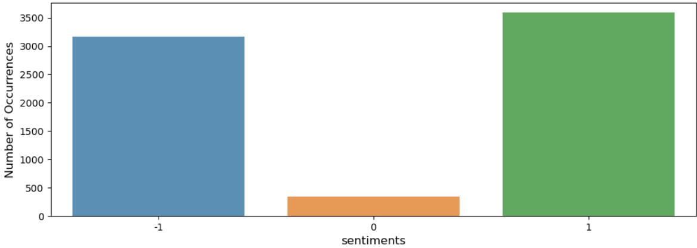
Data Exploration
Notes:
As you can sees we have similar number of negative sentiment and positive sentiment, and small portion of neutral sentiment.

Slide 17
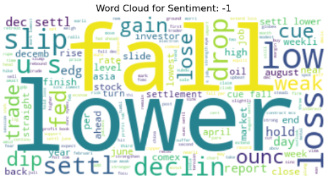
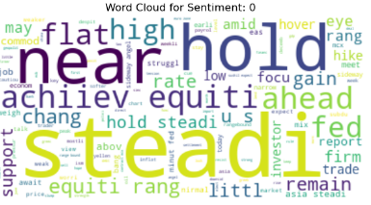
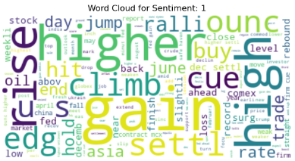
Data Preprocessing
Preprocessing
Remove Specific words
Remove Duplicate
Filter words length
Tokenization
Lowercase
Conversion
Stemming

Slide 18
Text Analytics
3.RandomForest
With Train-test Split
4.RandomForest
With Cross Validation
1.VADER
2.Rule-Base
Accuracy: 40.615%
Accuracy: 67.635%
Accuracy: 92.529%
Accuracy: 91.255%
IGNORE MODEL
IGNORE MODEL
BEST PERFORMANCE
ENSURE NOT OVERFITING

Slide 19
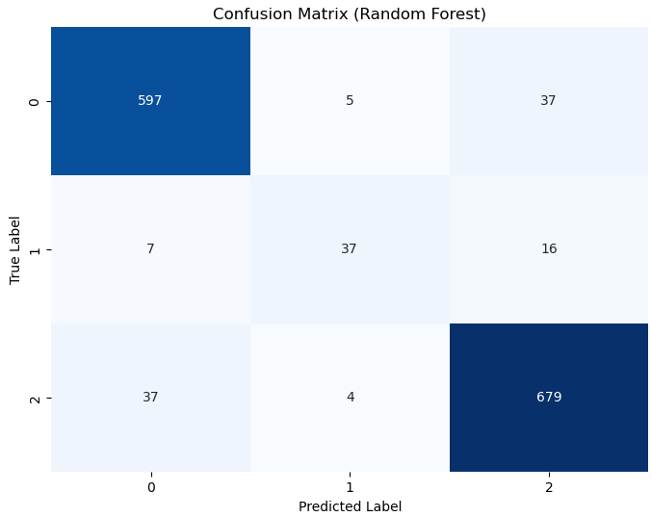
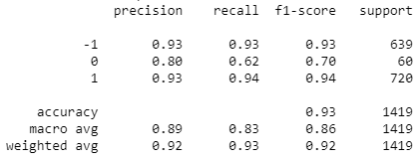
Evaluation
Confusion Matrix
(Random Forest)
Classification Report

Slide 20
Part 3: The Combination of Classification dataset and Sentimental dataset For Gold Price Prediction

Slide 21
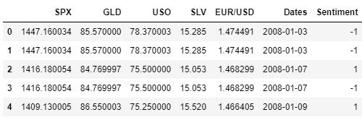
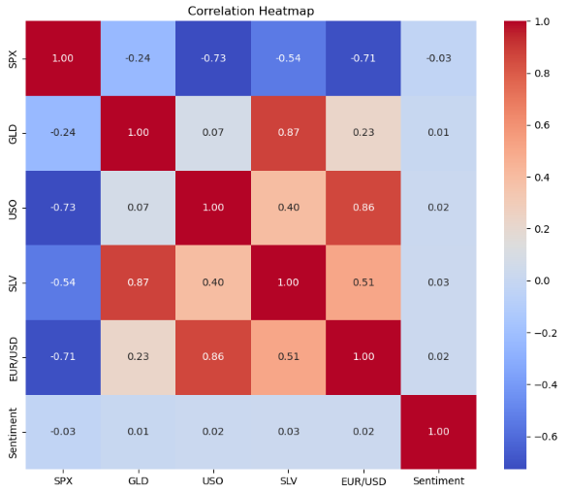
Integrate Two Datasets
Correlation Heatmap
Correlation Heatmap
Notes:
We combine two datasets into one and find the correlation every columns.
Obviously, sentiment column from second dataset has low relationship with the target variable.
The limitation of this dataset could occur from these reason:
1.News headline provide sentimental price direction as different period of time that cannot compare to the same period of gold price.
For example, Some article might analyze gold price for the first quarter but the release date of this news is in May.
2.The original dataset retrieve from several URL that might has a conflict of sentimental direction.
For example, One source analyze first quarter and give a positive sentiment and second source analyze second quarter and give a negative sentiment.
However, these two sources has the release date that will create a label conflict.

Slide 22
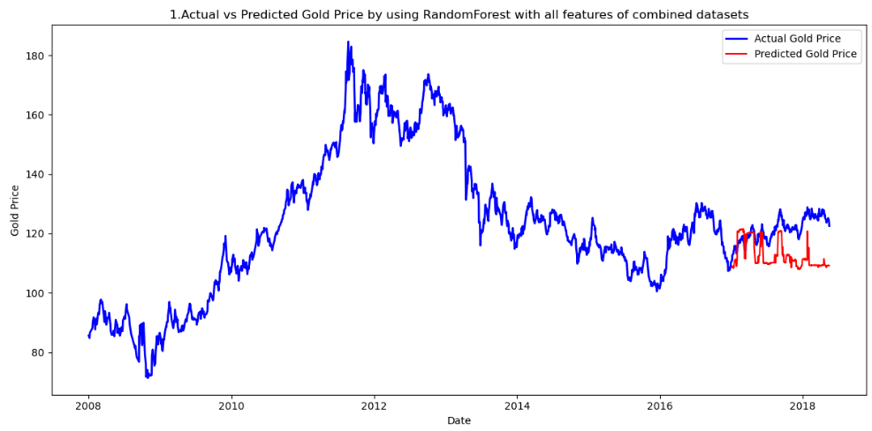
Apply First Model to Predict Gold Price

Slide 23
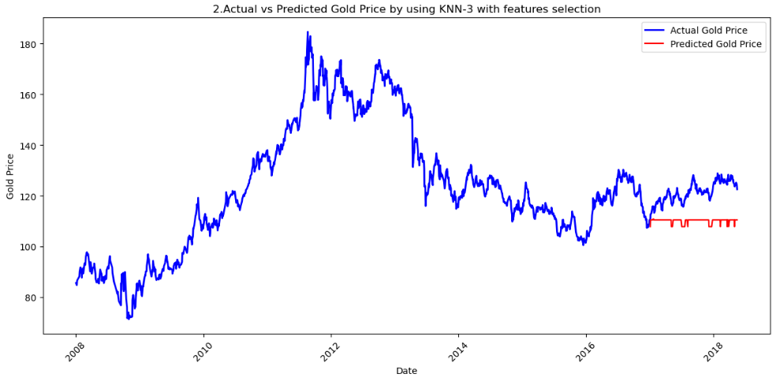
Apply Second Model to Predict Gold Price

Slide 24
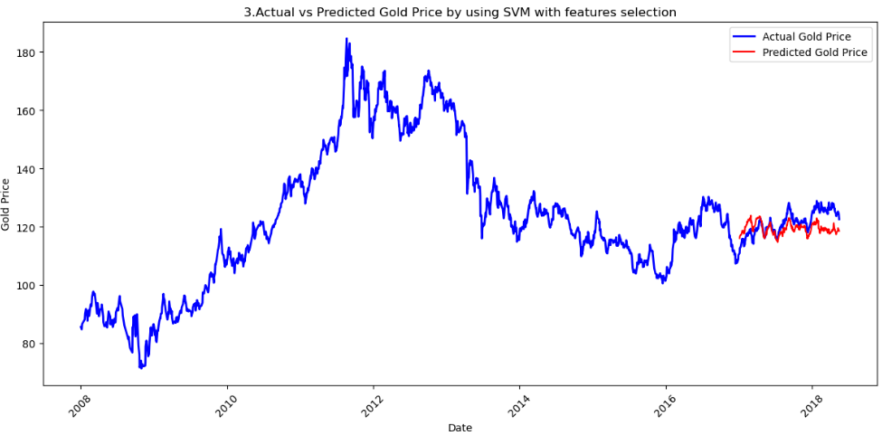
Apply Third Model to Predict Gold Price

Slide 25
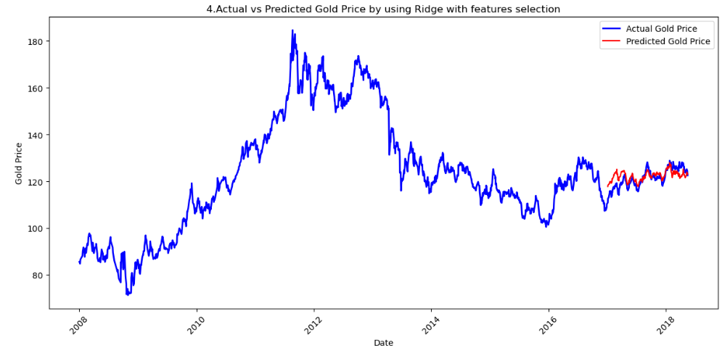
Apply Fourth Model to Predict Gold Price

Slide 26
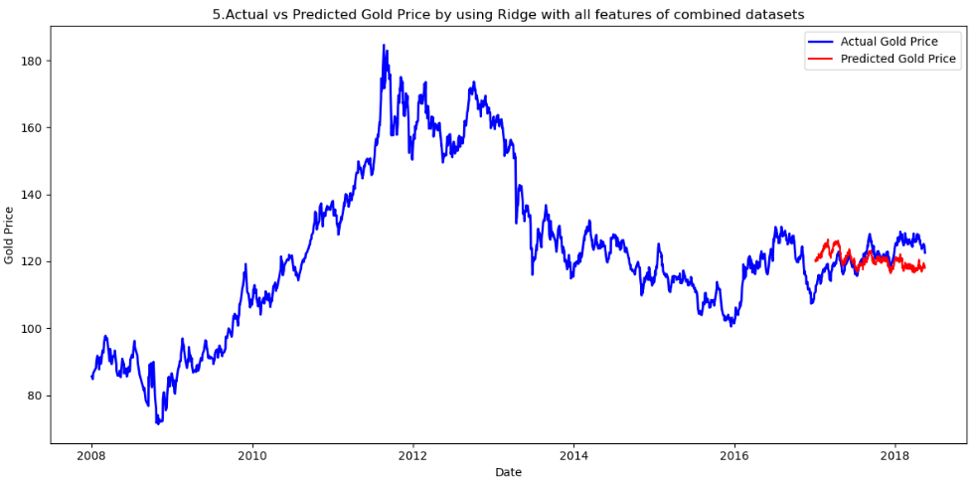
Apply Fifth Model to Predict Gold Price

Slide 27
Apply Fifth Model to Predict Gold Price

Slide 28
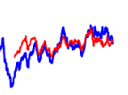
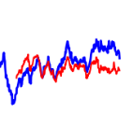
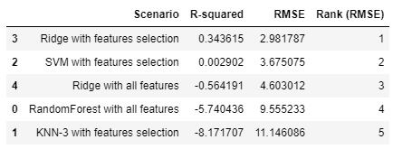
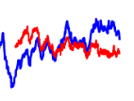
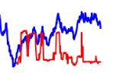
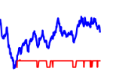
Summary results
BEST
4.Ridge with two features
3.SVM with two features
5.Ridge with all features
1.RF with all features
WORST
2.KNN with two features
Notes:
We can rank the best model by visualizing graph, the highest R-square or the lowest Root mean square error
In conclusion, Ridge regression with feature selection excellently performs in predicting gold prices compared to other models.
RandomForest with all features performs poorly, indicating that including irrelevant features can degrade model performance.
Moreover, KNN-3 with features selection has the highest prediction errors, implying that this model is not be sufficient for predictive gold price.

Slide 29
Reference of Datasets
1.Data set column (6 columns) all numerical data.
Source: https://www.kaggle.com/datasets/aakash013/gold-price-prediction-dataset
2. Sentiment Analysis of Commodity News (Gold).
Source: https://www.kaggle.com/datasets/ankurzing/sentiment-analysis-in-commodity-market-gold
​

Slide 30

Thank you

